Slide 1
GIS Programming
Prediction of seagrass habitat across the coastal shallow water of world using machine learning
Hafez Ahmad
Department of Wildlife, Fisheries, and Aquaculture, College of Forest Resources, Mississippi State University, Mississippi, USA

Slide 2
Machine learning
Machine learning is branch of Artificial intelligence. ‘Learning is any process by which
system improves performance from experience’- Herbert Simon
Types of Learning
Supervised learning
Unsupervised and self –supervised learning
Transfer learning / Reinforcement →Deep learning
Traditional Modeling
Input
System
Output
Model
Machine learning has proven useful for a very large number of applications in many parts of the earth system (land, ocean, and atmosphere) and beyond, from retrieval algorithms,
Marine and coastal water monitoring
Ocean dynamics and Pollution detection
Habitat Mapping
Classification and change detection
New product creation
Bias correction
and code acceleration
Machine learning
Input
System
Model
Output

Slide 3
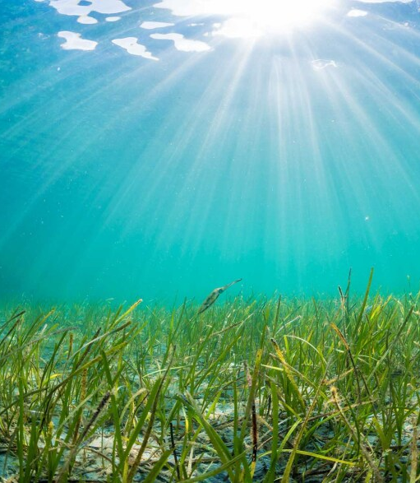
Project
Seagrass is a vital ecosystem that plays a significant role in maintaining the health and biodiversity of coastal waters worldwide. However, due to human activities such as pollution and climate change, seagrass habitats have been rapidly declining, posing a threat to the marine ecosystem. Therefore, predicting the distribution of seagrass habitats across coastal shallow waters is crucial for conservation efforts and effective management strategies.
Goal: To developed a machine learning model using the Random Forest Classifier algorithm to predict the distribution of seagrass habitats across coastal shallow waters worldwide.
Independent variables: Dissolved Oxygen, nitrate, phosphate, salinity, silicate, Elevation and water temperature.
Dependent: Occurrence of seagrass

Slide 4

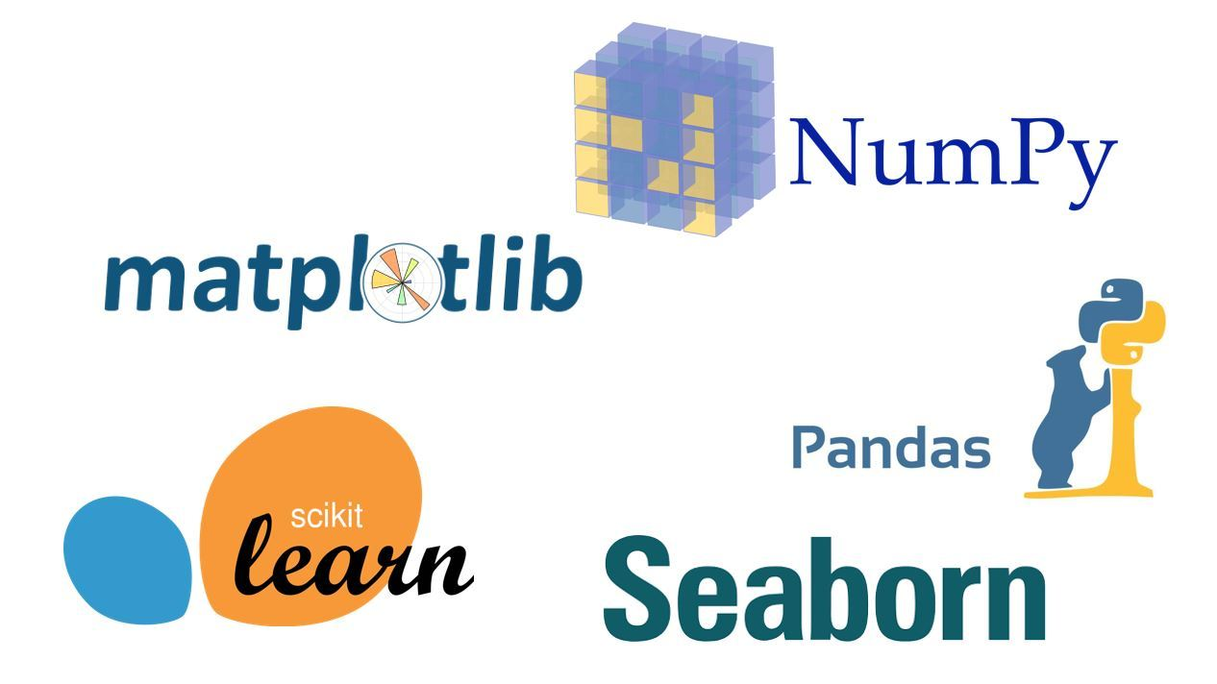

Machine learning
Python Packages
Arcpy(use of ArcGIS function using python)
OS (Path)
Pandas ( Data manipulation)
Numpy (Array)
Geopandas(Spatial data manipulation)
Scikit-learn (Machine learning)
The code is divided into four parts.
1st part is the importing packages and functions,
2nd part is the data manipulation and
3rd part is the model formulation and the last the is the prediction and saving predicted raster

Slide 5
Machine learning
Data preparation
Select Independent Variables
Filling missing value
Select Dependent Variable
Random random point as training
Generate Points to Rasters
Extract variable wise for each variables
Factorize Dependent Variable [presence/absence]

Slide 6
Machine learning
Method for analysis and Prediction
Points
Variables
Filling missing
Kriging -Raster
Extract values
Add new Present column
0 for all
Select by layer
1 for selected
Convert to numpy array
Convert to pandas dataframe
Factorize present column
Test and Train set- 90%,10%
Model
Prediction
Evaluate
Numpy to feature class
Kernel density predicted seagrass

Slide 7
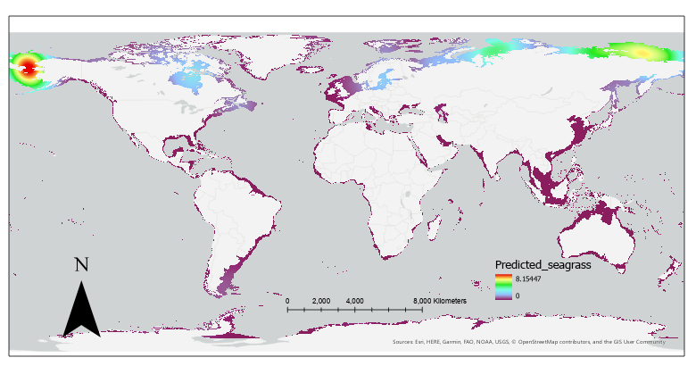
Output:
Predicted Raster from Machine learning Algorithm

Slide 8

Thank you so much

